Slide 1

Nyon-data, a Fall Detection Dataset from a Hinged Board Apparatus
The 8th Smart City Applications International
Conference
Rogério Dionísio, Ana Rafaela Rosa and Cassandra Sofia dos Santos Jesus
Polytechnic Institute of Castelo Branco, Portugal
October 4th, 2023 – ESTP Cachan, Paris, France

Slide 2
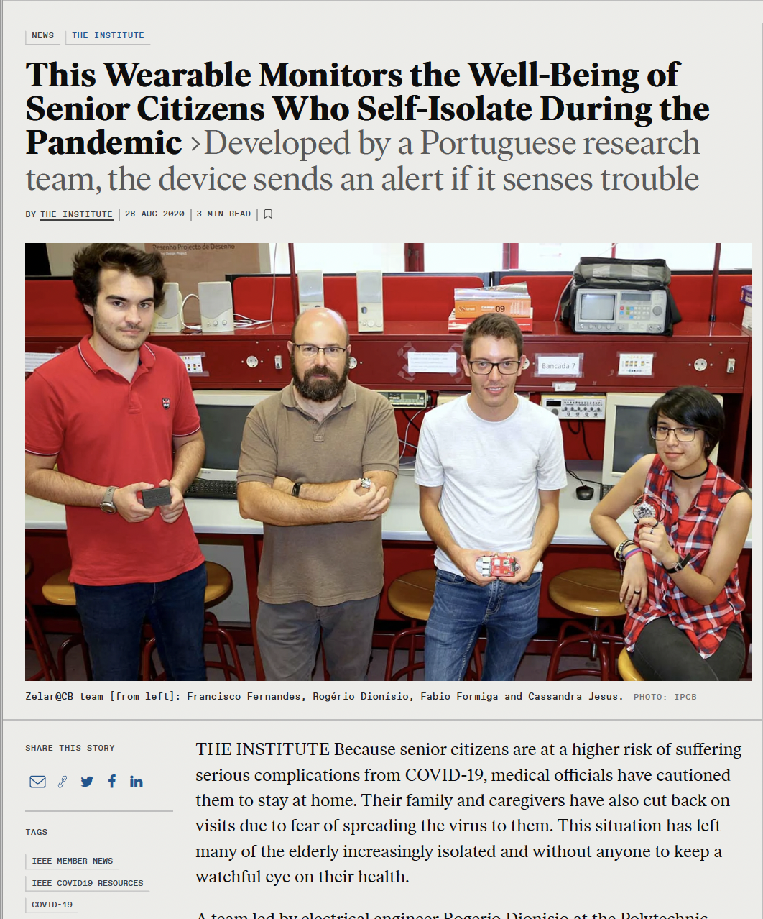
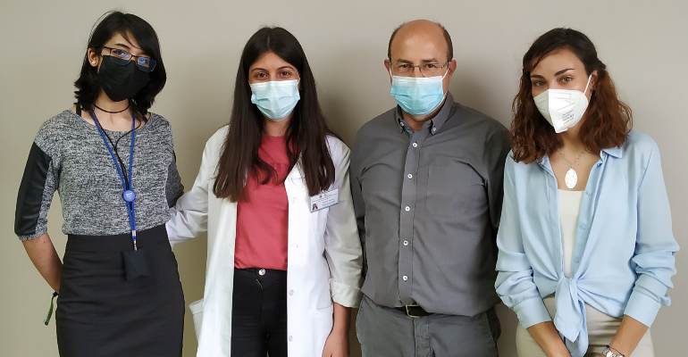
The team

Slide 3
Summary
Objectives
Dataset creation
Application with a fall detection algorithm
Results and analysis
Final comments

Slide 4

Rationale and objectives
Monitor elder fall detection and create a warning system
Wearable device
Limited contact due to COVID-19
Objectives:
  Generate a dataset focused on the Portuguese population
  Use an apparatus that mimics a human fall
  Test the dataset with a fall detection algorithm
Notes:
In 2021, Portugal ranked fourth on the list of the oldest population countries in Europe.

Slide 5
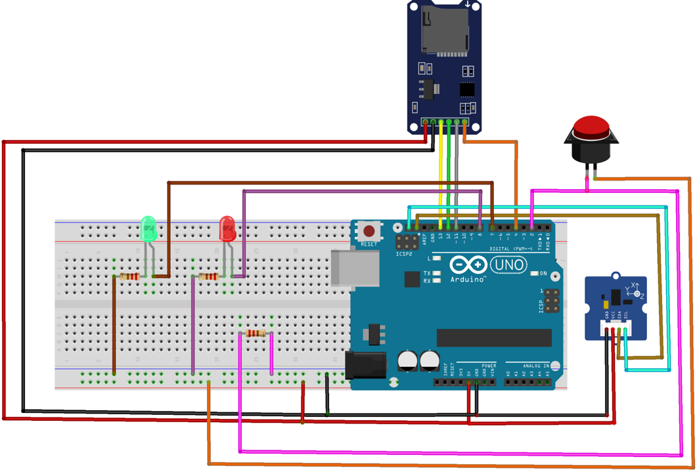
Datalogger Circuit
An Arduino UNO board;
A 3-Axis digital accelerometer (ADXL345);
A micro-SD card reader breakout board (Adafruit);
A push-button to control the start and completion of the data collection process;
A green LED to signal when the SD-card is recording;
A red LED to signal that the program was stopped successfully;
Several resistors for current limitation of the LED and the push-button;

Slide 6
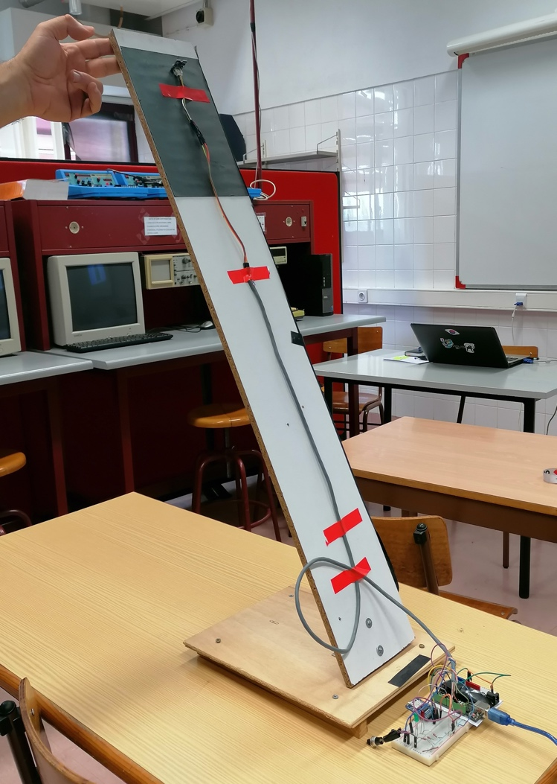
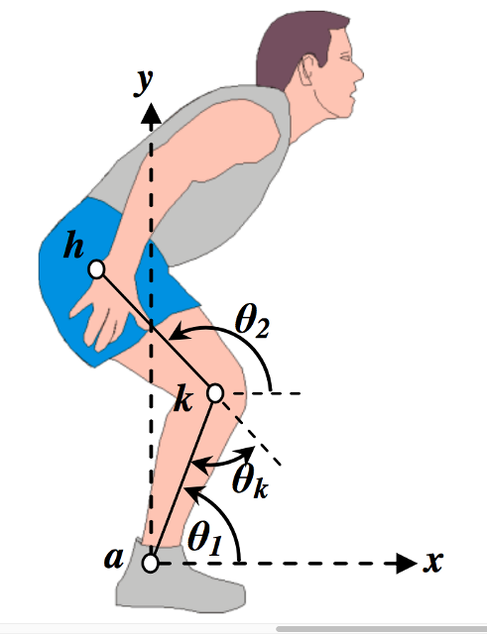
Hinged platform
Emulate a fall event.
Measurement levels:
Ankle (7 cm)
Knee (48 cm)
Hip (89 cm)
Measurement angles:
30º
45º
90º

Slide 7
Dataset description
Nyon_data Folder
Ankle_30.csv
time (s)
Ankle_45.csv
Acc. X (g)
Acc. Y (g)
Acc. Z (g)
Ankle_90.csv
Hip_90.csv
...
Knee_30.csv
3 fall events
for each file
https://github.com/rdionisio1403/Nyon/

Slide 8
Fall Detection Algorithm
Differential Sum Vector Magnitude
  Threshold algorithm
  3 axis accelerometer (x, y and z)
$$A_{DSVM}\left(n\right)=\sqrt{{\left(x_{n}−x_{n−1}\right)}^{2}+{\left(y_{n}−y_{n−1}\right)}^{2}+{\left(z_{n}−z_{n−1}\right)}^{2}}$$
Kim, N. H., & Yu, Y. S. (2013). Fall recognition algorithm using gravity-weighted 3-axis accelerometer data.
Journal of the Institute of Electronics and Information Engineers, 50(6), 254-259

Slide 9
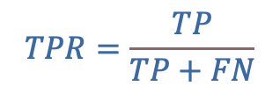

Receiver Operating Characteristic (ROC)
Best Threshold
Binary classification
$$TPR=\frac{TP}{TP+FN}$$
$$FPR=\frac{FP}{FP+TN}$$

Slide 10
Results
Dataset file | AUC | A_{dsvm} best threshold | FPR | TPR
hankle_30.csv | 83.1 % | 0.35 | 13.6 % | 92.5 %
hankle_45.csv | 79.0 % | 0.30 | 14.4 % | 90.0 %
hankle_90.csv | 76.0 % | 0.20 | 18.6 % | 90.5 %
knee_30.csv | 72.4 % | 0.35 | 11.7 % | 87.7 %
knee_45.csv | 62.8 % | 0.25 | 14.0 % | 78.5 %
knee_90.csv | 72.0 % | 0.40 | 10.0 % | 99.8 %
hip_30.csv | 87.0 % | 0.30 | 15.0 % | 93.7 %
hip_45.csv | 82.3 % | 0.40 | 15.2 % | 81.0 %
hip_90.csv | 80.3 % | 0.25 | 20.3 % | 88.2 %
Mean value | 77.2 % | 0.31 | 14.8 % | 89.1 %
Std Deviation | 7.3 % | 0.07 | 3.16 % | 6.43 %
Area Under the Curve: 77.2 %
Best Threshold (DSVM): 0.23
  FPR = 14.8 %
  TPR = 89.1 %
No clear correlation between the results and the sensor position or angle.

Slide 11
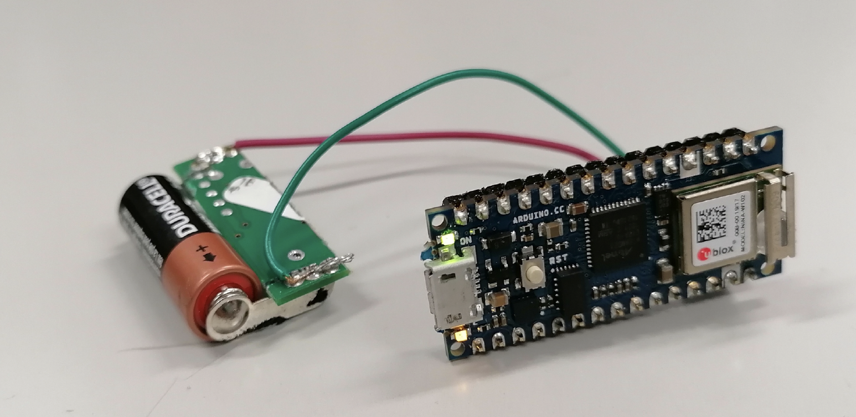
Final comments
The Arduino UNO platform is simple to program but powerfull enough to fullfill the objectives of the datalogger.
  Limitation: Sampling time
A new device is under development, battety powered and lightweight (Arduino Nano Sense)
  Energy restrictions
  Low computational complexity
  Simple algorithm
  WiFi / Bluetooth

Slide 12

Thank you for your Attention!
The 8th Smart City Applications International
conference
rdionisio@ipcb.pt

