Slide 1






Multicriteria Spatial Analysis to evaluate strawberry tree biophysical suitability
Luís Quinta-Nova^{1,2}, Sílvia Ribeiro³, Natália Roque¹, Maria Margarida Ribeiro^{1,4} (email: lnova@ipcb.pt)
¹ Instituto Politécnico de Castelo Branco, Escola Superior Agrária, Castelo Branco. Portugal
² Centro de Geobiociências, Geoengenharias e Geotecnologias, Aveiro. Portugal
³ Centro de Investigação em Agronomia, Alimentos, Ambiente e Paisagem, Lisboa. Portugal
⁴ Centro de Estudos Florestais, ISA-UTL, Lisboa. Portugal
World Congress Silvo‐Pastoral Systems 2016,
Universidade de Évora
27 September 2016

Slide 2
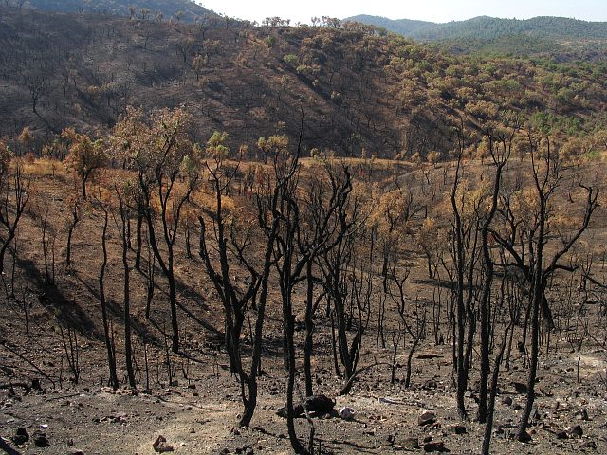
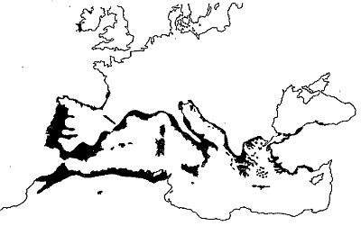
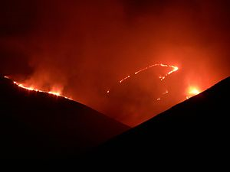
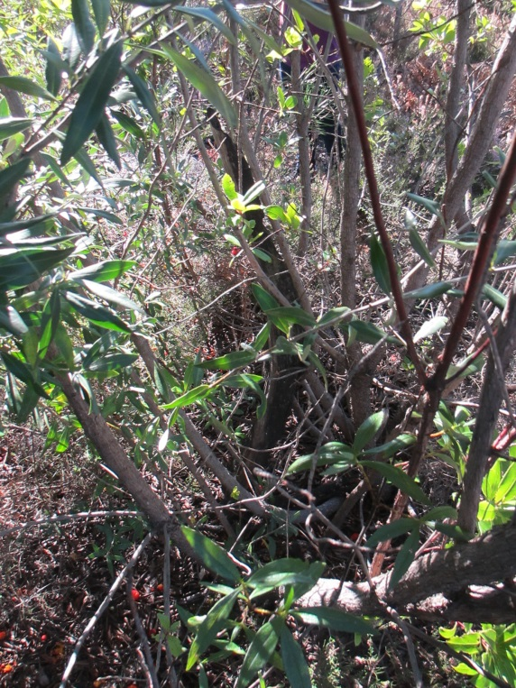
Framework
…the strawberry tree is a native species, tolerant to water stress, low soil fertility and it has an active resistance to forest fires...
http://www.botanicgardens.ie/herb/research/arbutus.htm

Slide 3
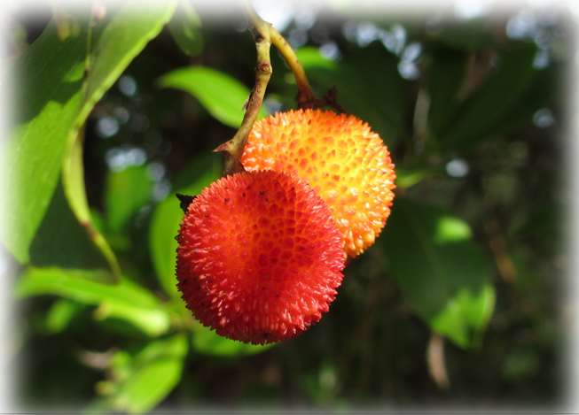
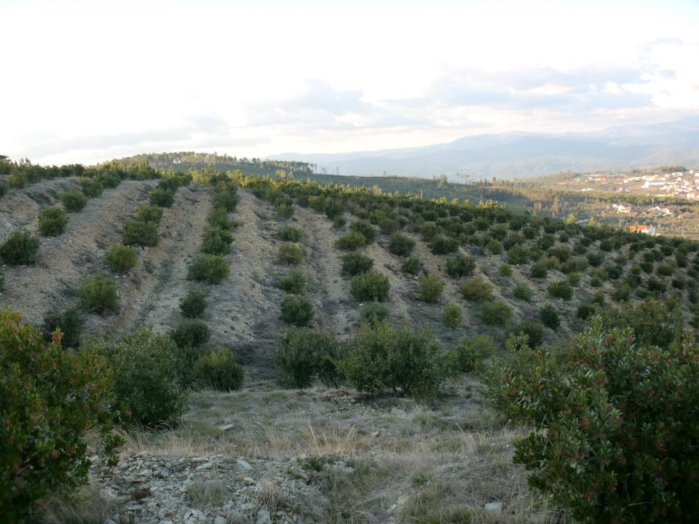
Framework
…the fruit is used in the production of a brandy, the main source of income
…the consumption of red fruit (arbutus) with antioxidant potential is a new opportunity.
…the willingness of producers, supported by financing, to invest in modern plantations, using improved plants…

Slide 4
Project ARBUTUS
Objectives
Ecological characterization of 15 strawberry tree natural populations
To identify the main ecological factors that influence the potential distribution of
Arbutus unedo
To model the suitability for the species in Beira Baixa region
To relate the ecological factors with genetic diversity patterns
What is the genetic structure of populations?
Suitability Map

Slide 5
Location of the studied strawberry tree populations
Sigla | Proveniência | Região
BV | Barranco do Velho, S. do Caldeirão | Sotavento - Algarvio
HP | Herdade da Parra | Silves
M | Monchique | Barlavento S. Monchique
EC | Espinhaço do Cão (sopé ocidental ~ Aljezur) | S. Espinhaço do Cão
A | Mata do Solitário | S. Arrábida
SM | S. São Mamede | S. São Mamede
AV | Alvoco da Serra e Vide | Guarda
PS | Pampilhosa da Serra | Coimbra
ON | Oleiros Norte, | Castelo Branco
SF | Sertã – Figueiredo, Sul
G | S. Gardunha | S. Gardunha
V | Viseu | Viseu
B | Bragança | Bragança
VR | Vila Real | Vila Real
MA | Mata de Albergaria | Peneda-Gerês

Slide 6
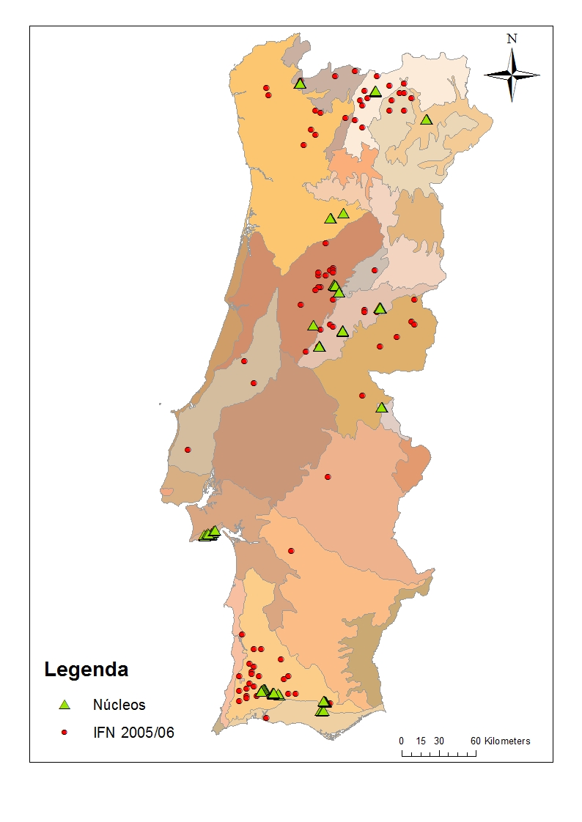
Location of the 15 populations/
Portuguese Forest Inventory (2006)

Slide 7
Biophysical variables
Strawberry tree
populations
Buffer
1km
Bioclima
Topography
Landscape metrics
Fires
Soil
Ombrotermic index
Aspect
Land use (COS)
Burned areas
FAO Soil Map
Termicity index
Slope
Shannon index
Number of forest fires
Active calcium, pH, density…
Topographic Position index

Slide 8

Sample collection of 30 trees in 15 populations
Population + Buffer
(1 km)

Slide 9
Ombrotermic Index (IO)
Monteiro-Henriques, T 2010.
Fitossociologia e paisagem da bacia hidrográfica do rio Paiva/Landscape and phytosociology of the Paiva River’s hydrographical basin.
Ph.D. thesis.. Instituto Superior de Agronomia – TULisbon. Lisboa. Portugal

Slide 10
Topographic Position Index (TPI)
Notes:
The topographic position index reflects the difference in elevation between a focal cell and all cells in the neighborhood.

Slide 11
Burned areas
Notes:
A análise descritiva da ocorrência de incêndios florestais em Portugal é baseada na informação histórica para um período de 38 anos (1975 a 2012). A cartografia das áreas ardidas foi obtida através da classificação semi-automática de imagens de alta rede detecção remota a partir de imagens de Landsat Multi-Spectral Scanner (MSS), Landsat Thematic Mapper (TM), and Landsat Enhanced TM+). Foi identificado para este período um total de 35198 perímetros de incêndio com áreas iguais ou superiores a 35 hectares no período de 1975 a 1984 e áreas iguais ou superiores a 5 hectares a partir de 1985. A cartografia de análise foi realizada pelo Laboratório de Detecção Remota do Instituto Superior de Agronomia.
Cruzou-se com recurso a ferramentas do software ArcGis 10.2 os perímetros das
áreas ardidas com os nossos pontos de amostragem

Slide 12
PCA (Principal Component Analysis)
Exploratory multivariate statistical approach→ characterization of biophysical variables associated with the areas
Land use: Shannon index (SDI)
Wildfires: number of fires and burned area
Topography: altitude, slope, aspect and TPI (topographic position index)
Soils: % sand, % silt, % clay, pH, % organic matter, % active Ca (CaCO₃), bulk density, C/N ratio.
Bioclima: Termicity index (I_{t}) e Ombrotermic index (I_{o}).

Slide 13
1

Slide 14
PCA (Principal Component Analysis)
Results
Cluster 1 (Arrábida) → explained by a high ratio C/N in the soil and high values of TPI and termicity index values.
Cluster 2 (Algarve) → High values of termicity index, and low values of ombrothermic index. Presence of CaCO3 in soil.
Cluster 3 (interior Center) → high quantity of OM in soil and high values of small size material in soil (silt and clay). This stands have intermediate values of SDI.

Slide 15
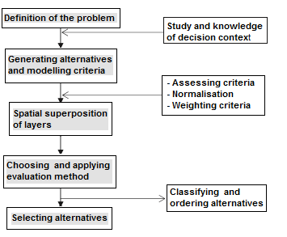
Multicriteria Spatial Analysis
Methodology
Figura 2: Fluxograma do processo analítico hierárquico (AHP)

Slide 16
Multicriteria Spatial Analysis
Classification of data in suitability levels
Source: Correia e Oliveira (1999 e 2003), Dias et al. (2008) e Silva e Neto (2013)
Criteria | Low sutability (1) | High suitability (2)
Annual Rainfall (mm) | 0-500; >1400 | 500-1400
Average of the minimum temperatures (ºc) | < 8 > 13 | 8-13
Average annual temperature (ºc) | < 15; > 20 | 15-20
Freeze (nr. days/year) | > 40 | < 40
High intensity rain (nr. days with R ≥ 10 mm) | > 30 | < 30
Hail (nr. days/year) | > 5 | < 5
Altitude (m) | < 50; > 700 | 50-700
Soil drainage (% sand) | < 50 | > 50
Soil - pH | < 5; >7,2 | 5-7,2
Soil - Organic matter | < 3 | > 3
Vegetation series | Other vegetation series | Poterio agrimonioidis - Querceto suberis S.; Pyro bourgaeanae - Querco rotundifoliae S.; Smilaco asperae - Querco suberis S.; Arbuto unedonis - Querco ppyrenaicae S; Arbuto unedonis - Querceto pyrenaicae S.; Junipero oxycedri - Querceto rotundifoliae S.
Bioclima (It x Io) | Other bioclimas | Meso-mediterranean; supra-mediterranean; dry-superior; sub-humid and humid
Aspect | Other terrain orientations | SW; S; W

Slide 17
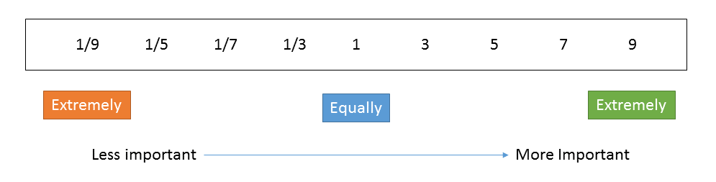
Pairwise Comparation matrix (expert consultation)
Critérios | Annual rainfall | Minimum temp. | Average temp. | Freeze | Soil Ph | Soil OM | Soil drainage | Altitude | Bioclima | Veget. series | Aspect
Annual rainfall |  | 1/5 | 1 | 1 | 1/3 | 1/3 | 1/3 | 3 | 1 | 1/5 | 3
Minimum temperature |  |  | 7 | 3 | 5 | 5 | 5 | 3 | 1 | 1/3 | 5
Average temperature |  |  |  | 1/3 | 3 | 3 | 3 | 3 | 1 | 1/3 | 3
Freeze |  |  |  |  | 1/3 | 1/3 | 1/3 | 1 | 1/3 | 1/5 | 3
Soil pH |  |  |  |  |  | 3 | 1/5 | 5 | 1/3 | 1 | 3
Soil organic matter |  |  |  |  |  |  | 1/7 | 5 | 1/3 | 1 | 3
Soil drainage |  |  |  |  |  |  |  | 5 | 1/3 | 1 | 3
Altitude |  |  |  |  |  |  |  |  | 1/5 | 1/3 | 1
Bioclima |  |  |  |  |  |  |  |  |  | 1 | 5
Vegetation series |  |  |  |  |  |  |  |  |  |  | 5
Aspect

Slide 18
Multicriteria Spatial Analysis
Criteria weights
Criteria | Weight w_{ij}
Annual Rainfall (mm) | 0,0454
Average of the minimum temperatures (ºc) | 0,2132
Average annual temperature (ºc) | 0,0943
Freeze (nr. days/year) | 0,0511
Altitude (m) | 0,0252
Soil drainage (% sand) | 0,1233
Soil - pH | 0,0758
Soil - Organic matter | 0,0625
Vegetation series | 0,1319
Bioclima (It x Io) | 0,1556
Aspect | 0,0217
CR < 0,1

Slide 19
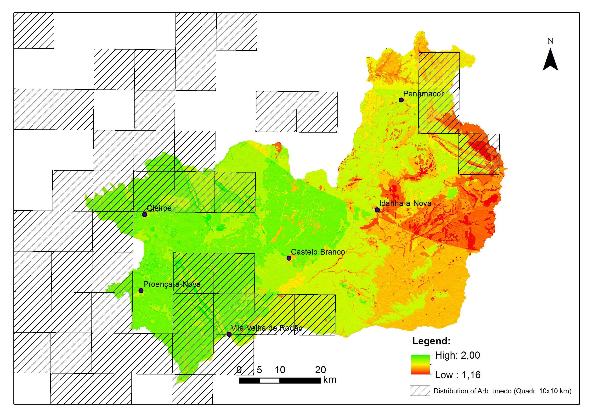
Multicriteria Spatial Analysis
Strawberry tree Suitability Map

Slide 20
Multicriteria Spatial Analysis
Considerations
The combination of MCE and GIS methods can therefore be seen as a powerful tool for solving power planning problems.
Minimum air temperatures and Bioclima are the most influencial factors in the species distribution.
The potential distribution and the actual distribution of Arbutus unedo have a positive correlation.
The Suitability Map could be useful for management authorities and stakeholders supporting decisions.

Slide 21
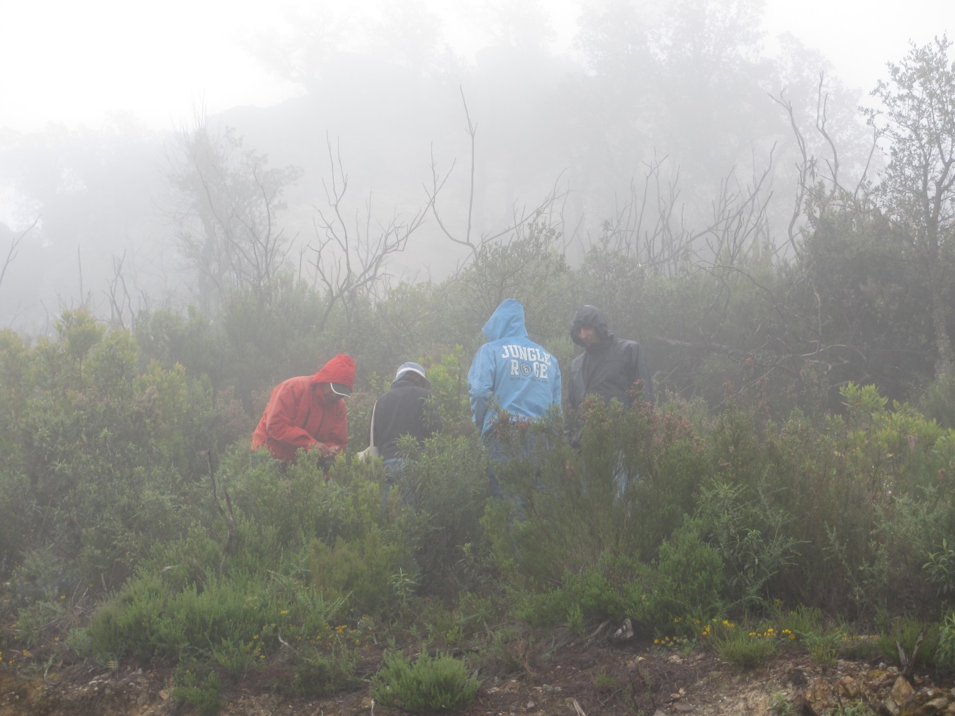
Thank you

